Slide 1
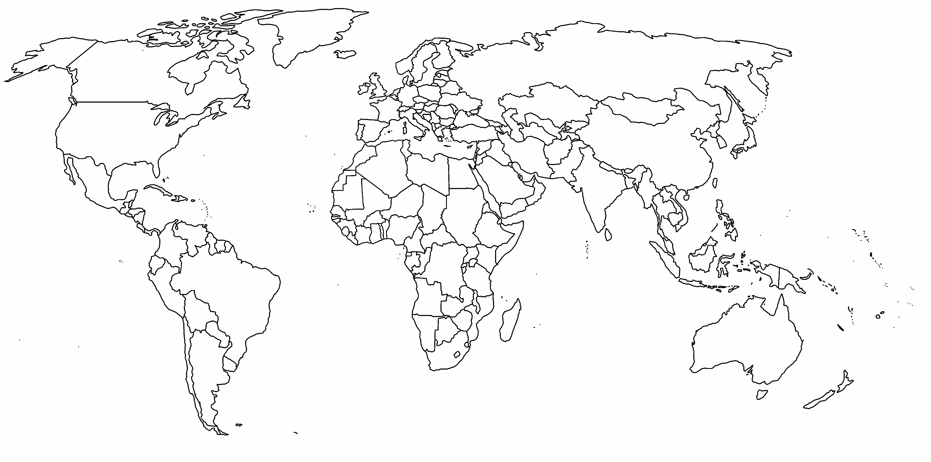
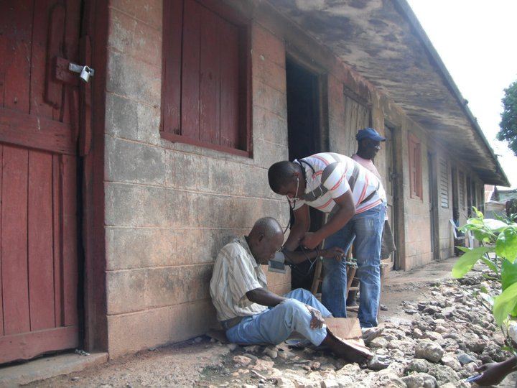
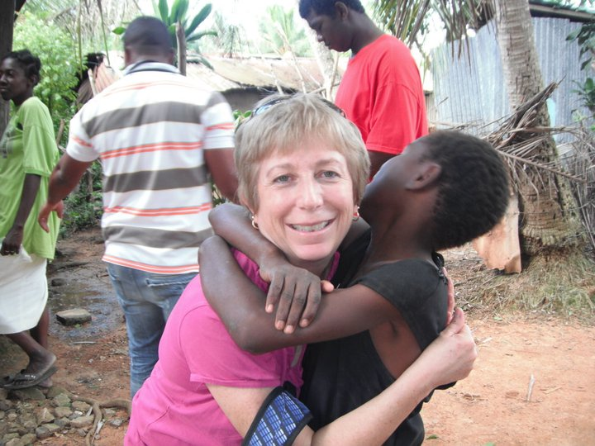
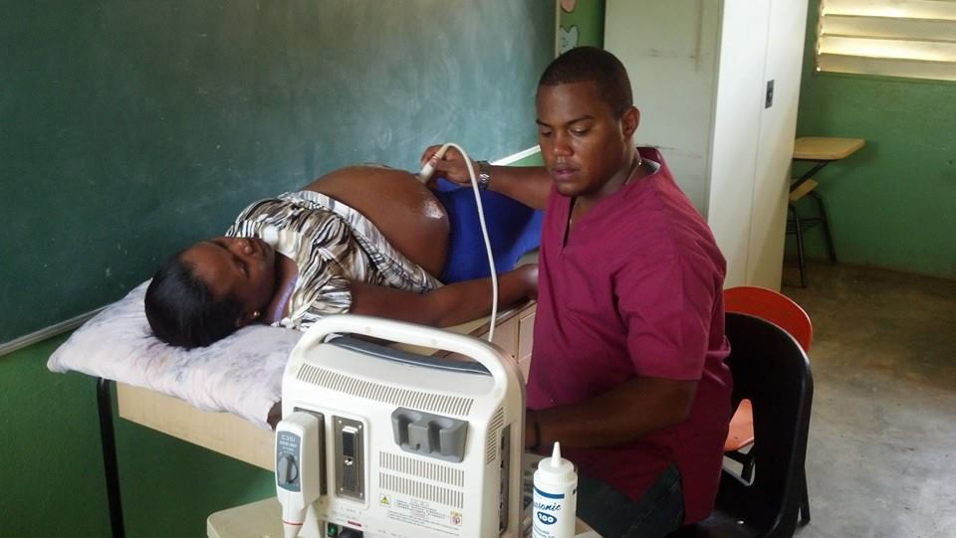

Implementation of a Global Health Curriculum within the
University of Alabama Family Residency Program
Natalie Kuijpers MD, Jane Weida, MD, Kathryn Kouchi
The University of Alabama
BACKGROUND
Global Health: the area of study, research and practice that places a priority on improving health and achieving equity in health for all people worldwide (6)
Residents and medical students have participated in global health experiences for decades. More residents are acquiring international experiences, despite having inadequate guidance and support from accredited organizations and residency programs (1,2).
Although 54% of U.S Family practice residency programs have some form of global health curriculum, only 15.3% provided significant support (3).
Medical students who have completed global health experiences have been shown to (3,4,5):
Have increased skills and confidence
Have increased sensitivity to cost in health care
Have greater appreciation for cross-cultural communication
Perform better on their licensing exams
Express more interest in primary care
Have a better understanding of socio-economic factors in health
Report positive experiences
Recommend an experience to others
A committee at UAFMR has been formed to develop and implement a global health curriculum which began in July 2017.
METHODS
IRB approval for the study was acquired.
Residents and medical students at UAFMR were asked to complete a researcher generated survey on their attitudes towards global health experiences and curriculum development.
The 10-item survey contained two “yes” or “no” questions and eight Likert type statements.
RESULTS
CONCLUSIONS
Descriptive analyses were performed.
Cronbach’s alpha for the 8 statements was .839, indicting internal consistency.
Approximately 47% of respondents (n=47) had previous experiences in global health.
Overall, respondents supported implementation of the global health curriculum.
Since the implementation of the Global Health Curriculum:
There has been good attendance at the meetings
Several faculty and staff members have expressed interest and are participating in future meetings
With the upcoming ERAS match, applicants will be able to see that Global Health is part of UAFMR’s program
Interest has encouraged further meetings and lectures to be planned
32%
Were comfortable treating a patient who presents with travel-related symptoms
23%
Feel comfortable assisting a patient with pre-travel medication consultation
36%
Agree that an established Global Health curriculum impacted or will impact their decision on ranking a residency program
“Global health allows us to expand our horizons outside of Alabama and to be more culturally competent providers.”
- John Lundeen M.D., PGY-2
77%
Believe that a Global Health Curriculum would be beneficial in their education and future career
81%
Agree that experiences in Global Health would allow them to be a more culturally competent and compassionate physician
87%
Agree that learning how to treat chronic conditions in a resource poor community can help them take better care of the patients in their own community
OBJECTIVES
FUTURE DIRECTIONS
The purpose of this study was to assess resident and medical student perceptions of :
The need for a formal global health curriculum.
2. The benefits of global health to their future practices.
Future studies will be performed to evaluate resident and student attitudes after implementation of this curriculum.
We can also study the relationship between resident participation Global Health Curriculum and performance on training exams.
72%
Believe that participating in an international experience would improve their physical exam skills
79%
Agree that a global health experience would improve their communication skills
85%
Would be interested in participating in a Global Health experience, time and funding permitting
REFERENCES
Drain, P. K., Primack, A., Hunt, D. D., Fawzi, W. W., Holmes, K. K., & Gardner, P. (2007). Global health in medical education: a call for more training and opportunities. Academic Medicine, 82(3), 226-230.
Drain, P. K., Holmes, K. K., Skeff, K. M., Hall, T. L., & Gardner, P. (2009). Global health training and international clinical rotations during residency: current status, needs, and opportunities. Academic medicine: journal of the Association of American Medical Colleges, 84(3), 320.
Schultz, S. H., & Rousseau, S. (1998). International health training in family practice residency programs. Family Medicine, 30(1), 29-33.
Izadnegahdar, R., Correia, S., Ohata, B., Kittler, A., ter Kuile, S., Vaillancourt, S., ... & Brewer, T. F. (2008). Global health in Canadian medical education: current practices and opportunities. Academic Medicine, 83(2), 192-198.
Sweeney, S. (2016). A resident’s perspective on why global health work should be incorporated into family medicine residency training. Family Medicine and Community Health, 4(1), 53-54.
Koplan, J. P., Bond, T. C., Merson, M. H., Reddy, K. S., Rodriguez, M. H., Sewankambo, N. K., & Wasserheit, J. N. (2009). Towards a common definition of global health. The Lancet, 373(9679), 1993-1995.
College of Community Health Sciences

